Slide 1

ENVIROMENTAL WEEK 14 PROJECT
Presented to DR: INJY ATTIA
DONE BY: Mohamed Moghazi : 19100650
Eyad Mohamed: 19101450
Mohamed Khaled : 19103220
Mohamed Elmaghraby : 19102722
Mohamed Farag : 19100876

Slide 2
INTRODUCTION:
In this research on "Global Environmental Changes and Their Impacts," we aim to assess and understand the multifaceted shifts in global climate, population dynamics, and sea level rise. This study is focused on identifying how these changes will affect both the natural world and human societies up to the year 2100. By systematically gathering and analyzing current data, projecting future trends, and exploring mitigation strategies, our goal is to provide a comprehensive blueprint for addressing the challenges posed by these global environmental shifts.

Slide 3
Literature review:

Slide 4
1.1 Impact of Population Growth on Environmental Degradation: Case of India:
The research paper explores the relationship between rapid population growth in India and its impact on the environment. The study investigates the consequences of population growth on land, forest, water, and energy resources. Findings suggest that high population growth rates lead to increased population density, a higher number of people below the poverty line, and subsequent pressure on natural resources, contributing to environmental degradation. The paper discusses the effects of population growth on land degradation, soil erosion, deforestation, and the decline of per capital land, forest, and water resources. The study concludes with policy reflections and emphasizes the crucial role of natural resource conservation. The authors, Sarbapriya Ray and Ishita Aditya, are affiliated with the University of Calcutta and the University of Burdwan, respectively. The paper underscores the need for concerted efforts, including education and local initiatives, to address environmental challenges associated with population growth in India.

Slide 5
1.2 IMPACT OF POPULATION EXPLOSION ON ENVIRONMENT
This document delves into the multifaceted impacts of population growth on the environment, emphasizing the alarming strain that the burgeoning human population places on Earth's delicate ecosystems. It begins by highlighting the staggering pace of population increase, emphasizing the shift from 1 billion in 1800 to 6 billion in just two centuries, with half residing in urban areas. The study underscores the critical connection between population size, affluence, and environmental impact, citing examples of greenhouse gas emissions, soil erosion rates, and species extinction. The intricate interplay between population growth and physical environment degradation is thoroughly examined, covering issues such as deforestation, air and water pollution, depletion of the ozone layer, and land/soil degradation. The consequences of these environmental challenges are elucidated, including global warming and climate change, with the document providing alarming statistics on rising global temperatures and their implications. The narrative also sheds light on the extinction of species, attributing it to human activities and emphasizing the value of biodiversity. The comprehensive exploration of each environmental concern is accompanied by insightful explanations of its causes and repercussions. The document concludes with a call for urgent population control measures, asserting that the Earth's finite environment is at risk of irreversible destruction without immediate intervention. Overall, it provides a detailed and well-supported argument for the necessity of addressing the complex interplay between population growth and environmental sustainability through targeted policies and actions.

Slide 6
1.3 The Effect of Population Growth on the Environment: Evidence from European Regions
This comprehensive study investigates the intricate interplay between population growth and environmental repercussions within European regions, presenting a departure from conventional cross-country analyses by concentrating on regional-level intricacies. Utilizing a dataset spanning 1062 regions across 22 European countries during the years 1990 to 2006, the research meticulously explores the impact of population growth on two pivotal dimensions of environmental degradation: carbon dioxide (CO2) emissions and shifts in urban land use. Against the backdrop of the shifting European narrative, where concerns about overpopulation in the late 20th century have transformed into contemporary worries about declining population trends, this study sheds light on the nuanced regional disparities. The findings notably reveal that in Western Europe, burgeoning population rates align with escalated urban sprawl and heightened CO2 emissions, potentially conflicting with the region's ambitious climate goals. In stark contrast, Eastern Europe, marked by declining populations, exhibits no discernible correlation between population growth and these environmental markers. The study not only underscores the importance of regional specificity in understanding the population-environment nexus but also raises pertinent concerns about the implications of future population growth, notably spurred by immigration, in the context of the European Union's ambitious climate objectives. The intricate dynamics underscore the need for tailored policy responses that acknowledge regional variations and emphasize the complexities involved in achieving sustainable development goals in the face of demographic shifts.

Slide 7
1.4 Impact of Population Growth on Environment: THE DEBATE HEATS UP
This paper explains the link between population growth and environmental woes is entangled, not straightforward. While a surging population strains resources and fuels problems like deforestation, DCs with fewer people consume most. Poverty, inequality, and political instability often drive environmental damage, not just numbers. Addressing these complexities, paired with technological leaps, is key to a sustainable future, not just population control. Forget just blaming population growth for LDC environmental woes. The real culprits are deeper. Government policies favoring big businesses over traditional farming hurt the land. Conflicts and refugee influxes devastate ecosystems. Rich countries' trade practices and limited aid keep LDCs poor and desperate, pushing them to overuse resources. To truly heal the environment, we need to tackle these complex issues, not just count heads.

Slide 8
1.5 Impact of Population Growth on Environmental Degradation and Effect on Human Health
This paper delves in the ups and downs of a population's headcount, is a key development factor to consider. The past 50 years saw a global boom, fueled by plunging death rates, especially in developing countries after World War II thanks to medical advancements. However, this wasn't uniform. While most developing nations have followed suit with falling birth rates since the 1960s, places like Sub-Saharan Africa and the Middle East stand out, still experiencing significant population increases. It's a complex dance, with birth and death rates playing starring roles, and regional variations adding their own flavor to the story. Our objective is to analyse cause of population growth, degradation of environment and obtain more Hands to Overcome Poverty. One of the most famous theories about the relationship between population and resources is Malthusian theory, which was developed by Thomas Malthus in the late 18th century. Malthus argued that population growth would eventually outstrip the ability of the Earth to produce food, leading to widespread famine and poverty. However, Malthus did not foresee the technological changes that have accompanied modernization and allowed agricultural output to increase faster than population growth. Other scholars, such as Ester Boserup, have argued that population growth can actually lead to increased technological innovation and resourcefulness. Boserup suggested that in some cases, population growth and resulting increased population density might induce technological changes that allow food production to keep pace with population growth. Water, food, forests, wildlife - all threatened by more and more people consuming and polluting. Overpopulation linked to environmental damage, aggression, and resource tension. Sustainable solutions urgently needed for a harmonious future. Due to cause of Population Growth environmental and surrounding will be polluted and its affect to effect directly human life and overuse of Coal, oil and natural it has started producing some serious effects on the environment. Rise in the number of vehicles and industries have badly affected the quality of air. Rise in amount of Co2 emissions leads to global warming.

Slide 9
Factors Description:

Slide 10
1.Population Growth:
The world's population is projected to reach nearly 10 billion by 2050. Most of this growth is expected in developing regions, especially Africa and Asia. Rapid population growth in these areas challenges resources like water, food, and energy. In contrast, some developed countries face aging populations and declining birth rates. Population growth intensifies environmental pressures as the increased demand for resources leads to higher greenhouse gas emissions and habitat loss.
2.Temperature Change:
Global temperatures have increased by approximately 1.2°C since the pre-industrial era, mainly due to the accumulation of greenhouse gases in the atmosphere. This warming is causing shifts in weather patterns, leading to more extreme events like heatwaves, droughts, and heavy rainfall. Continued temperature rise can exacerbate these impacts, threatening agriculture, water resources, and human health.
3.Sea Level Rise:
Sea levels are rising at an accelerating rate, currently averaging 3.3 millimeters per year. This rise is due to the melting of polar ice caps and glaciers, and the expansion of seawater as it warms. Coastal areas and small island nations are particularly vulnerable, facing increased flooding, erosion, and, in some cases, complete submergence.
4.Population Exposure to Sea Level Rise:
Over 600 million people live in coastal areas that are less than 10 meters above sea level, putting them at direct risk of sea level rise. This exposure can lead to displacement, loss of property and livelihoods, and increased vulnerability to storm surges and coastal flooding.

Slide 11
5.Species Loss:
Climate change is a critical driver of biodiversity loss, affecting species’ survival, reproduction, and distribution. Changes in temperature and precipitation patterns disrupt ecosystems, leading to habitat loss and altered food web dynamics. This loss of biodiversity can reduce ecosystem resilience, affecting services like pollination, water purification, and carbon sequestration.
6.Impact of High Temperatures on Populations:
Higher temperatures can lead to heat-related illnesses and deaths, particularly among vulnerable groups like the elderly, children, and those with pre-existing health conditions. Extreme heat also impacts mental health, labor productivity, and increases the risk of wildfires. Additionally, it can exacerbate droughts, affecting water supply and agriculture.
7.Strategies for Controlling Global Temperature Rise:
Mitigating global temperature rise involves reducing greenhouse gas emissions through transitioning to renewable energy, improving energy efficiency, and adopting sustainable transportation. Reforestation and sustainable land use practices can enhance carbon sequestration. International agreements like the Paris Agreement aim to limit global warming to well below 2°C above pre-industrial levels.

Slide 12
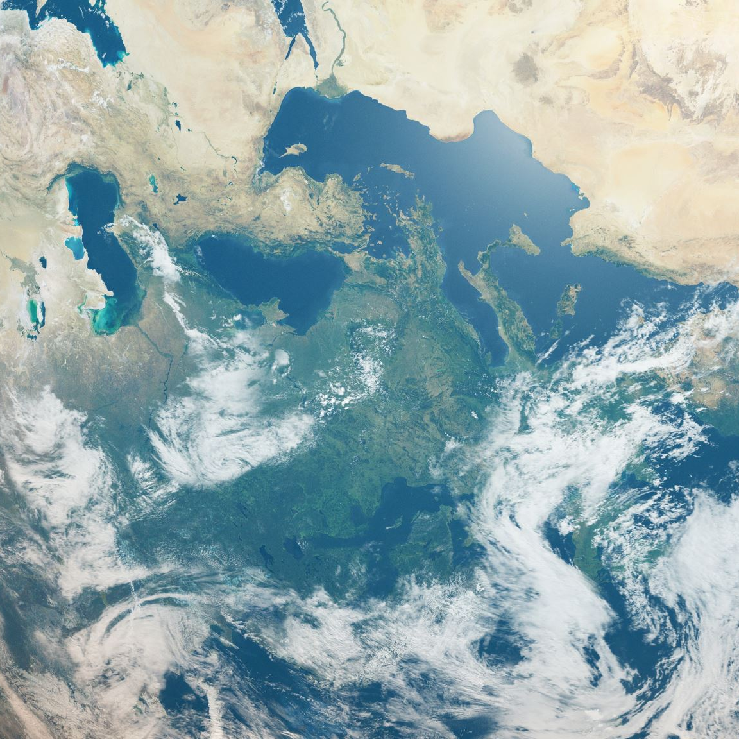
Simulation Results and Analysis:
Global Scenario:
In this section the global simulation results for population growth and its impacts on the environment are going to be shown.

Slide 13
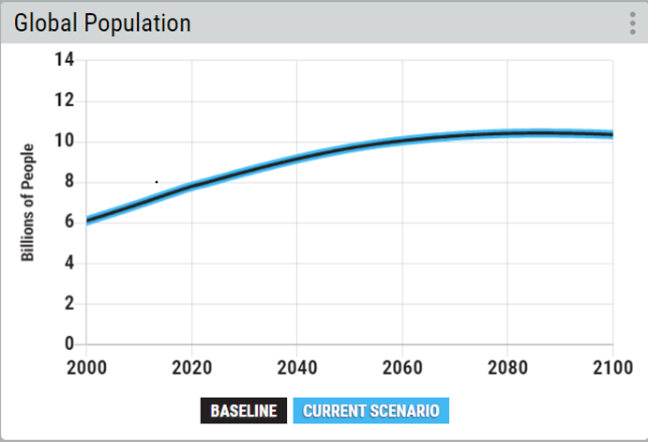
Population Growth:
The graph shows the expected growth in global population till the year 2100. The current global population is about 8.01 billion people, and it is expected to keep rising to reach about 10.35 billion people by 2100 if no actions were taken to mitigate it. While the overall trend is a rise in numbers it is also quite clear that the rate of increase gets slower over time especially from 2060 onwards.

Slide 14
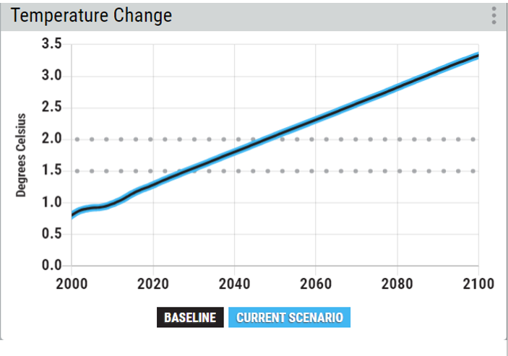
Temperature Change:
The graph shows the global change in temperature until the year 2100. The current baseline temperature increase in temperature is about 1.37 degrees Celsius and expected to increase to about 3.33 degrees Celsius by 2100 if no actions were taken to mitigate that. The rate at which the change in temperature is increasing is almost constant about +0.03 from one year to the other especially starting from 2020 meaning that it will not stop anytime soon.

Slide 15
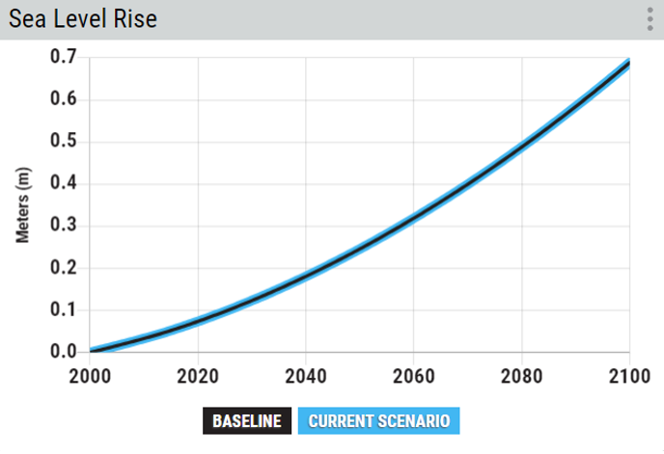
Sea Level Rise:
The graph shows the rise in sea level until the year 2100. The sea level rise is expected to reach about 0.69 meters by 2100, an increase of almost 8 times than the current baseline level of 0.09 meters. The quick rise shown by the graph indicates that this is not stopping anytime soon unless action is taken to mitigate it.

Slide 16
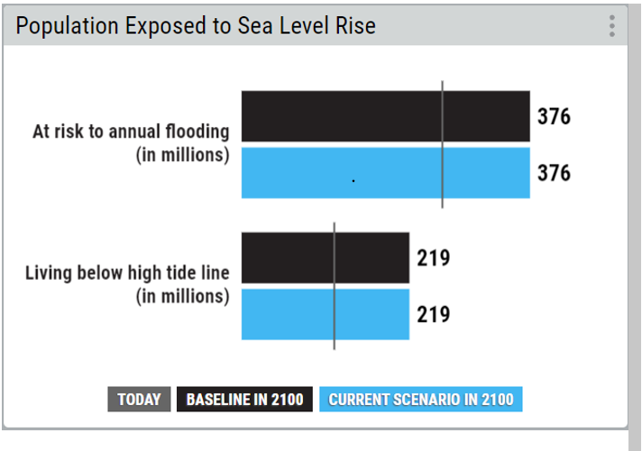
Population Exposure to Sea level rise:
The chart shows the number of people exposed to sea level rise in millions till the year 2100. Currently, the number of people at risk of annual flooding (indicated by the grey line) is about 261 million people and the number is expected to reach 376 million by 2100. The high tide line is the highest point on the shore reached by sea water during times of high tide. People living below high tide line are at greater risk of dying from the rise in sea level. That number is currently about 120 million and expected to reach 219 million by 2100

Slide 17
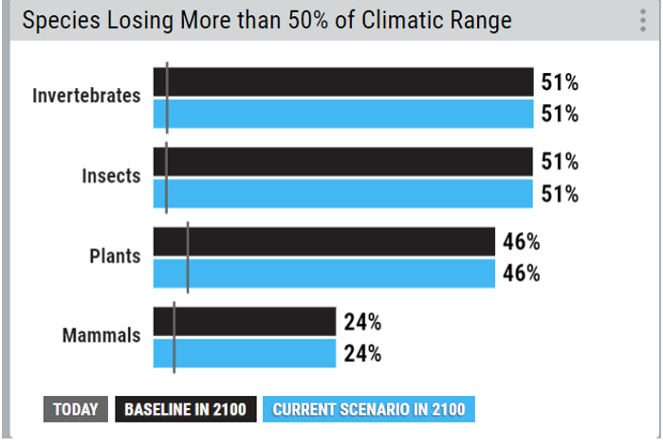
Species losing their climatic range:
Climatic range means the geographical and climate conditions in which species can thrive. The graph shows the expected percentage of species of each organism class to lose more than 50% of these optimal conditions. Invertebrates and insects are the most affected classes, about 51% of species are expected to lose their climate range, followed by plants at 46% then mammals at 24%. These numbers are huge compared to current estimates (indicated by gray lines) which are 2%, 2%, 4% and 3% respectively.

Slide 18
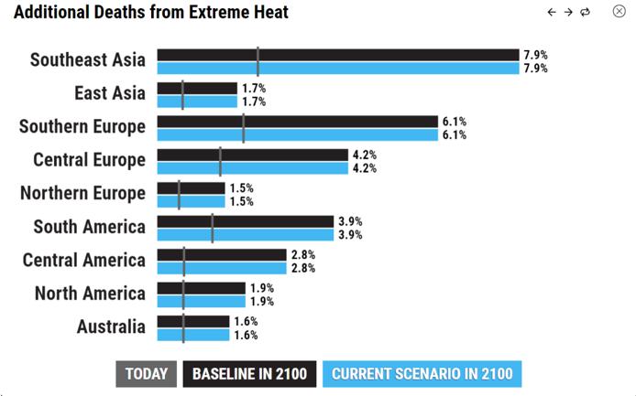
Global Death by Heat:
The chart shows the expected percentage of death by heat by 2100 in each region around the world. Southeast Asia is expected to be the most affected at about 7.9% of deaths will be due to extreme heat followed by southern Europe at 6.1% then south America at 3.9%. This metric specifically shows the criticality of global rise in temperature.

Slide 19
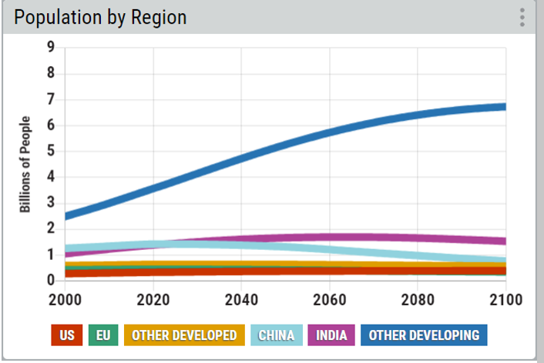
Population Growth Breakdown by Region:
As shown in the graph, developing nations are what is most contributing to the increase in global population. These countries include African nations, south and central America nations, south and southeast Asia nations, most middle eastern nations and some small island nations. Combined these nations’ populations are expected to reach 6.73 billion people by 2100. India is another developing nation shown on the graph, but its population will not continue rising, instead it is expected to remain constant at about 1.7 billion during the period from 2060 to 2072 before starting to decrease in the following years to reach 1.53 billion by 2100. This is still however greater than the current population which is 1.42 billion people. As for China its population will decrease to reach 0.77 billion by 2100 from the current 1.43 billion people. Moving on to the developed nations. The increase in US population over the 100 years will be so small (from 0.28 billion in 2000 to 0.39 billion by 2100) with the increase from current will be even less from 0.34 billion. Same could be said about the EU, however population over the years will slightly decrease from 0.43 in 2000 to 0.35 by 2100. As for the other developed nations which include Australia, Canada, New Zealand , Russia , the UK, Japan , Ice Land and Norway populations will very slightly decrease to 0.58 from the current 0.64.

Slide 20
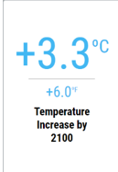
Global Increase in Temperature:
The global temperature is expected to increase by 3.3 degrees Celsius by 2100 if no actions were taken to reduce the mentioned impacts.

Slide 21
Suggested Plans by 2100 to reduce the global temperature by the afforestation, the Deforestation:

Slide 22
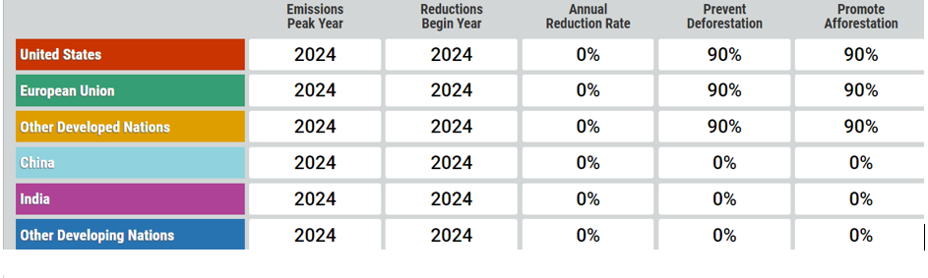
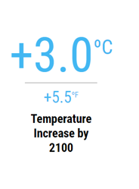
Scenario 1: Developed Countries applied optimum rate of 90% starting this year (2024):
The temperature would decrease by a whole 0.3 degrees than the expected temperature by 2100 if no actions were taken

Slide 23
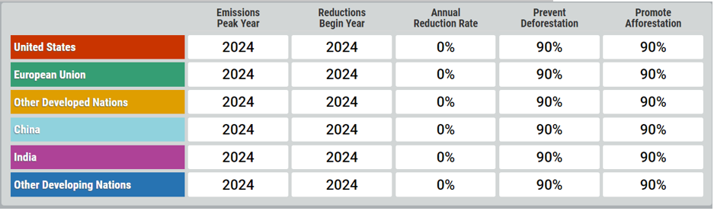
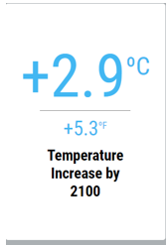
If developing nations would also follow it would yield even better results:
As shown, it would reach 2.9 degrees, a decrease of 0.4

Slide 24

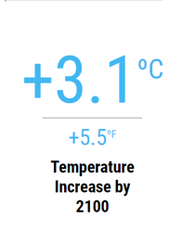
Scenario 2: Developed Countries applied average rate of 50% starting this year (2024):
As illustrated, it would decrease by 0.2 than the expected 3.3 degrees by 2100, while the percentage decreased a lot from the previous scenario the change in temperature was not that big from it.

Slide 25
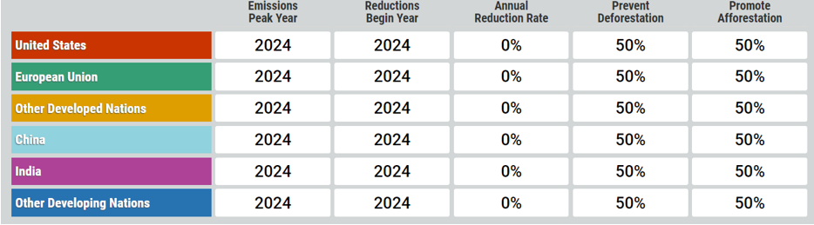
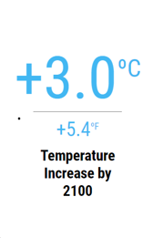
If developing countries did the same:
The change in temperature would be the same as if developed countries were in the ideal case.

Slide 26

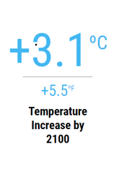
Scenario 3: Developed Countries applied bad rate of 5% starting this year (2024):

Slide 27

Unexpectedly, if all the developed countries improved afforestation and reduced deforestation by just 5% starting from this year, by 2100 the temperature will have increased by 3.1 degrees which is the same outcome as if they would reduce it by 50%.
The same result would be reached if developing countries joined.

Slide 28
Conclusion:

Slide 29
In conclusion, the current global scenario in terms of climate change is marked by a complex interplay of factors that include population growth, temperature changes, sea level rise, and biodiversity loss. Globally, the population is expected to continue growing, especially in developing countries, leading to increased demand for resources and environmental pressure. This growth poses significant challenges for sustainable development and climate mitigation efforts.
Temperature change, primarily driven by human-induced greenhouse gas emissions, is causing global temperatures to rise. This warming trend is altering weather patterns and increasing the frequency and severity of extreme weather events, affecting ecosystems, agriculture, and human health. Additionally, the melting of polar ice and glaciers, coupled with the thermal expansion of seawater, is contributing to rising sea levels. This poses significant risks to coastal communities around the world, including increased flooding and erosion, and could potentially displace large populations.

Slide 30
Furthermore, climate change is a major driver of biodiversity loss. Changes in temperature and precipitation patterns are disrupting habitats and food sources, leading to a decrease in species diversity. This loss of biodiversity threatens ecosystem resilience and the vital services they provide. High temperatures also pose direct and indirect effects on human populations, including heat-related illnesses, impacts on water supply and agriculture, and increased frequency of natural disasters like wildfires and droughts.
Looking ahead, current trends suggest a significant rise in global temperatures by 2100, which would have severe implications for the environment, human health, and economies. To address these challenges, a comprehensive and integrated global response is required. This includes reducing greenhouse gas emissions, transitioning to renewable energy, implementing sustainable land use practices, enhancing energy efficiency, and protecting and restoring ecosystems. Both international cooperation and local action are crucial in these efforts to mitigate the impacts of climate change and adapt to its changing conditions. The path forward requires a concerted effort across nations, communities, and individuals to foster a sustainable and resilient future.

Slide 31
References:

Slide 32
Nature. (2023, December 22). Nature. https://www.nature.com/
Home | MIT Climate Portal. (n.d.). MIT Climate Portal. https://climate.mit.edu/
IPCC — Intergovernmental Panel on Climate Change. (n.d.). IPCC. https://www.ipcc.ch/
Gillett, B. G. R. &. F. (2021, November 2). COP26: World leaders promise to end deforestation by 2030. BBC News. https://www.bbc.com/news/science-environment-59088498/
High tide line Definition | Law Insider. (n.d.). Law Insider. https://www.lawinsider.com/dictionary/high-tide-line
At COP25, UN agencies commit to turn the tide on deforestation | UN DESA | United Nations Department of Economic and Social Affairs. (n.d.). https://www.un.org/development/desa/en/news/sustainable/cop25-deforestation.html
Gillett, B. G. R. &. F. (2021b, November 2). COP26: World leaders promise to end deforestation by 2030. BBC News. https://www.bbc.com/news/science-environment-59088498
https://www.researchgate.net/publication/228839080_Impact_of_Population_Growth_on_Environmental_Degradation_Case_of_India
https://www.researchgate.net/publication/237771340_IMPACT_OF_POPULATION_EXPLOSION_ON_ENVIRONMENT
https://www.ncbi.nlm.nih.gov/pmc/articles/PMC6497702/
https://www.sciencedirect.com/science/article/pii/019592559290003G
https://ijrpr.com/uploads/V4ISSUE7/IJRPR15601.pdf

Slide 33

Thank you!

